Slide 1
Welcome
School of Business Information Technology Services
*Chris Buckridge, *Chris Zissis, Chris Hewitt, Chris Forte
*Provide Support for OPIM Virtual Desktop (OVD)
Notes:
Welcome to the University of Connecticut School of Business. We are Chris Buckridge and Chris Zissis, from the Information Technology Services Group and we provide top-level support for academic programs within the School of Business.
UConn has several IT service desks. Knowledge of each and its responsibility will help you get your issue addressed quickly
The hyperlinks in these slides will help you navigate to essential resources.

Slide 2
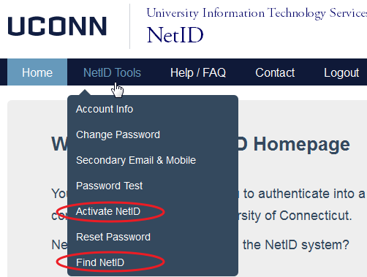
NetID
Activate your NetID
netid.uconn.edu
If you do not know your NetID
click “Find NetID”
NetID is needed for wireless access and the learning portal (HuskyCT)
Notes:
Activation of your NetID is an important first step to using UCONN resources.
Open a browser and go to netid.uconn.edu
If you do not know your NetID click NetID Tools then click “Find NetID”
If you know your NetID click “NetID Tools” then click “Activate NetID”
Your NetID is needed for wireless access and the (HuskyCT) learning portal
If you are on campus you might have to connect with an Ethernet patch cable

Slide 3
UCONN Wireless
UCONN-SECURE is available in Storrs and the GBLC.
Antivirus protection is required
(yes, even for Macs)
Windows Defender is already in Windows 8 and Windows 10
UConn Wireless
Notes:
UCONN-SECURE is available in Storrs and the GBLC. To connect to UCONN-SECURE, antivirus protection is required (already included in Windows 8 and Windows 10) Macs and Windows PCs are now required to have antivirus software running and up to date.
Free antivirus software is available at http://antivirus.uconn.edu/student.html.
Solutions may include:
https://www.avira.com/en/avira-free-antivirus.
http://www.avg.com/us-en/homepage.
More information is available here http://www.pcmag.com/article2/0,2817,2388652,00.asp.

Slide 4
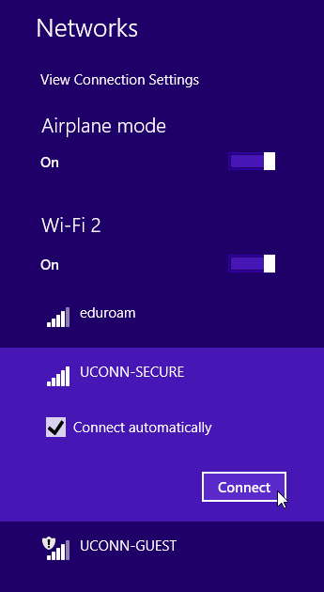
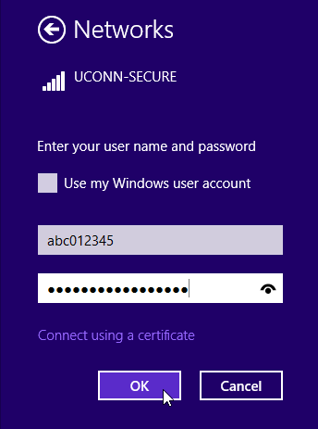
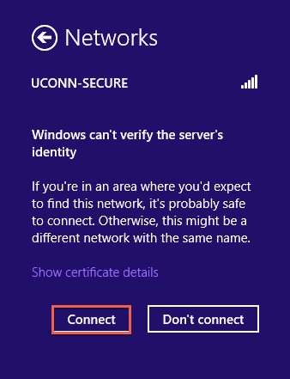
Windows 8 & 10
Notes:
For Windows 8 and 10 the wireless connectivity is easier.
Click on the Wifi Connection Icon.
Click on UCONN-SECURE. This network is isolated from the GUEST network. It permits use of UCONN and School of Business Network Resources. GUEST does not.
Enter your Activated NetID username.
Enter your NetID password, Click OK.
Accept the certificate.
Connection details for all devices is here: http://wireless.uconn.edu/uconn-secure/.

Slide 5
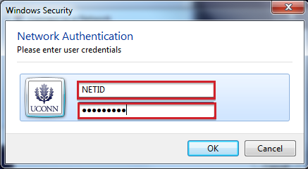
Connecting to UCONN-SECURE
If you are using Windows 7 please raise your hand for assistance.
Connection has to be created manually
WPA2 Enterprise
No certificate verification
Change MSCHAP (don’t pass local credentials)
Notes:
Your primary method to connect to UCONN resources will likely be through UCONN-SECURE while in Storrs, or at the GBLC.
Click the wireless icon in the notification bar.
Click "UCONN-SECURE“, then click "Connect“.
For "Username" type your NetID.
For "Password" type your NetID password, click "OK“.
More information is available here: http://wireless.uconn.edu/uconn-secure/windows7.
Often Windows 7 Wifi connections have to be manually created to disable certificate verification and to change the MSCHAP settings to local PC credentials are not used for wifi authentication.

Slide 6
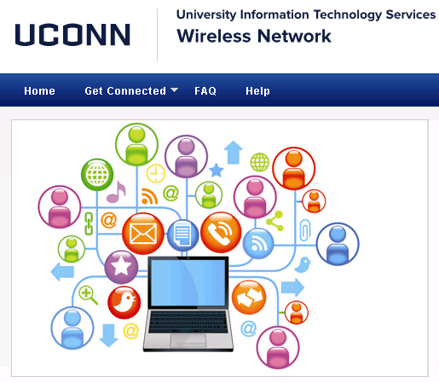
Connecting to UCONN-SECURE
For connection information related to other operating system please go to wireless.uconn.edu
Notes:
If you use Linux, Windows XP, or are having problems connecting to UCONN-SECURE please go to http://wireless.uconn.edu/uconn-secure/ for connectivity instructions.

Slide 7
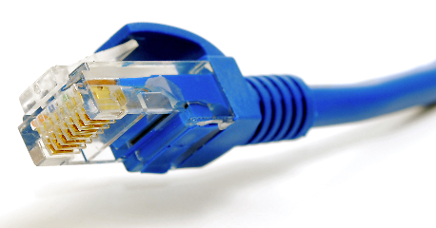
Best Connection Method
Ethernet
1000Mbps vs. 24Mbps
More stable
No disconnects
No authentication needed
Notes:
The best method of connecting to the School of Business network is to use an Ethernet patch cable
-Ethernet has significantly faster throughput.
-Ethernet is more stable
-There is no authentication needed to connect using Ethernet at the GBLC.

Slide 8
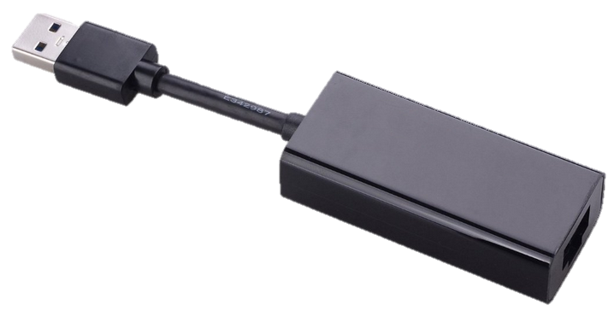
Ethernet
Reliable
Fast!
$3 - $10
Ultrabook user can use an inexpensive USB to Ethernet adapter $7 - $19
Notes:
Ethernet patch cables are available online for $3.00 to $10.00
If you have an ultrabook without an Ethernet jack you can use a USB to Ethernet adapter.
These adapters range in price from $7.00 to $19.00. Verify that the adapter supports your OS.
If your Laptop has USB 3.0 it is best to get one that is USB 3.0.

Slide 9
How to Access OPIM Virtual Desktops (OVD)
Notes:
The software you need for MSBAPM classes can be accessed with a single download from the web.
OPIM Virtual Desktop is your connection to a desktop in the cloud. A lab computer that is accessible from the Internet (Check with your Network Administrator if you are behind a corporate firewall. PCoIP protocols are required.
The latest version of the VMware View client is required.

Slide 10
What is Needed?
A Laptop, Desktop, or Tablet
Windows XP+, Mac OSX10.6+, Linux, iOS or Android OS
The LATEST VMware Horizon View Client
Notes:
What is needed to access OVD?
A device capable of running current versions of Windows, Mac OSX, Ubuntu, or Debian Linux, iOS or Android
The latest version of the VMware Horizon View Client.

Slide 11
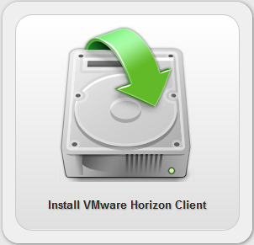
Downloading VMware Horizon Client
https://view.vpc.uconn.edu/
Click Install VMware Horizon Client
Notes:
Open a browser and go to https://view.vpc.uconn.edu/
Click Install VMware Horizon View Client

Slide 12
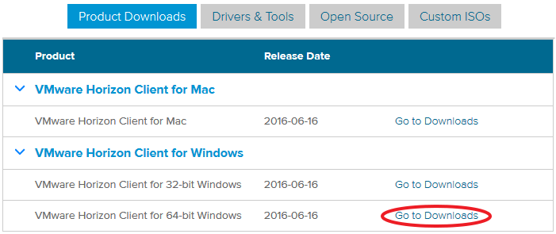
Select the View Client
Choose the correct client for your device or operating system (Window 64-bit).
Click Go to Downloads
Download the client
Notes:
Choose the correct client for your device or operating system.
Click Download
Note: Please do not download the client with the Local Mode Option

Slide 13
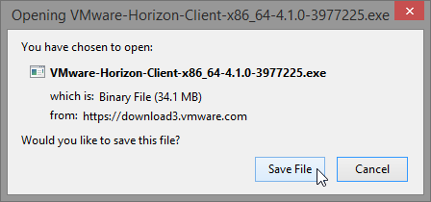
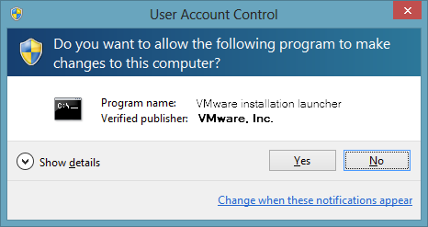
Follow prompts for client installation
Save
Start install
Notes:
Follow the prompts in the screen captures.
Save the Horizon Client file locally
Locate the downloaded file and double click on it to begin installation
Remember to save all open files and close other applications

Slide 14
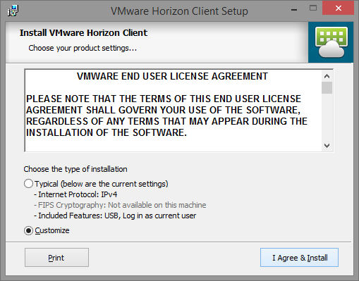
Follow prompts for client installation
Click Customize
Click I Agree & Install
Notes:
Click Customize
Click I Agree & Install

Slide 15
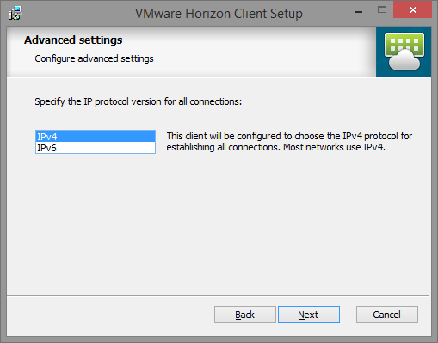
Follow prompts for client installation
Select IPv4
Click Next
Notes:
Select IPv4
Click Next

Slide 16
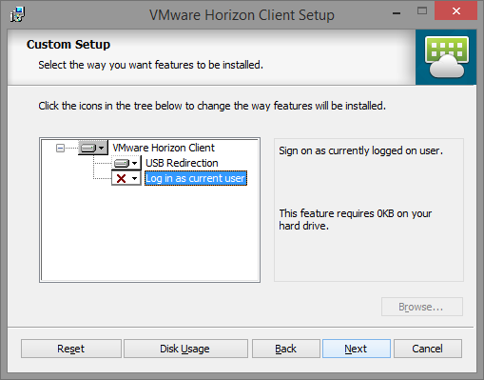
Follow prompts for client installation
Select USB Redirection
Deselect “Log in as Current user” to
It is Important to DISABLE this feature
Click Next
Notes:
Select USB Redirection
Deselect “Log in as Current user” to
It is Important to DISABLE this feature
Click Next

Slide 17
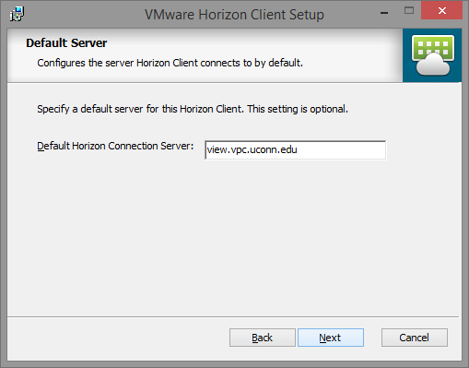
Default Connection Server
Enter view.vpc.uconn.edu
Click Next
Notes:
For the Default Horizon Connection Server enter view.vpc.uconn.edu
Click Next

Slide 18
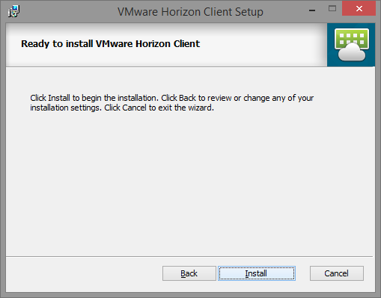
Follow prompts for client installation
Click Next
Click Install
Click Finished
If prompted restart your PC
Notes:
Choose your desired for placing shortcuts.
Click Next.
Click Install.
Click Finished when the installer completes.

Slide 19
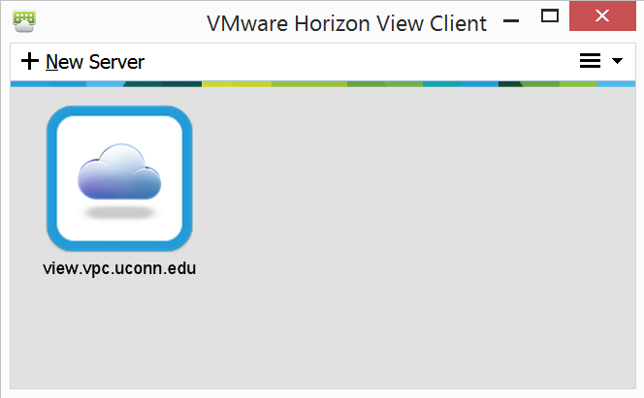
Connecting to OPIM Virtual Desktop
Start Horizon Client
Windows Start, Type VMware Horizon
Click on the icon
Click on view.vpc.uconn.edu
Notes:
Connecting to OPIM Virtual Desktop
Locate the Horizon Client application icon and click on it.
Click + New Server if “view.vpc.uconn.edu” is not listed.
Leave box for “Log In” as current user UNCHECKED if you see that option. Click “Connect”. (Windows only)
You will likely have completed these step from the previous slide.
Click View.vpc.uconn.edu to start a desktop session.

Slide 20
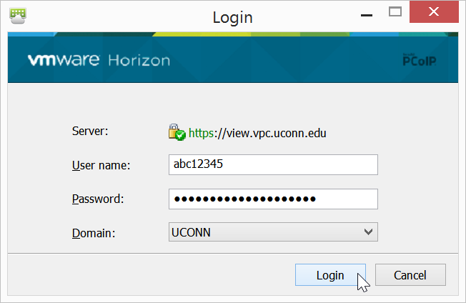
Signing into OPIM Virtual Desktop
Enter your NetID
Enter your NetID password.
Make sure the domain is “UCONN”
Click Login
Notes:
Signing into OPIM Virtual Desktop
Enter your NetID in the user name field
Enter your NetID password in the password field.
Make sure you select “UCONN” as the domain
Click Login

Slide 21
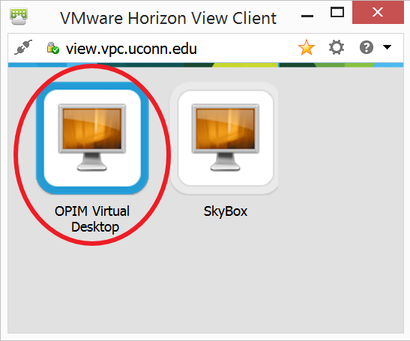
Choosing the right session
OPIM Virtual Desktop is the correct session.
It has your software
Send us an email with your NetID if you don’t see OPIM Virtual Desktop
SkyBox does not have your software
Notes:
OPIM Virtual Desktop is the correct session.
It has your software
Send us an email if you don’t see OPIM Virtual Desktop
Include your NETID
Send emails to cbuckridge@business.uconn.edu, and czissis@business.uconn.edu
SkyBox does not have all MSBAPM software

Slide 22
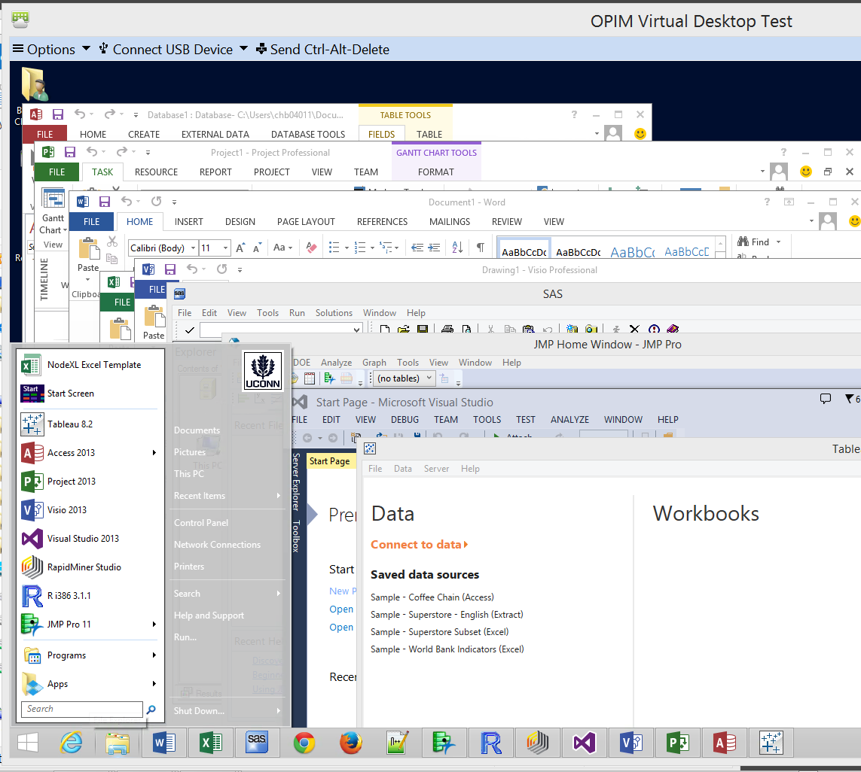
OVD Available Software
SAS 9.4, Enterprise Miner 12.1,
JMP Pro 12.01
Office 2013 Professional Plus
Access, Excel, Word, PowerPoint, Outlook, InfoPath, Project, Visio, OneNote
R, RExcel
RapidMiner
Oracle SQL Developer
Visual Studio 2013 Premium
Tableau Desktop
SPSS Data Modeler Premium 18
Notes:
This software is preinstalled.
SAS 9.4, Enterprise Miner 12.1,
JMP Pro 12.1
Office 2013 Professional Plus
Access, Excel, Word, PowerPoint, Outlook, InfoPath, Project, Visio, OneNote
R, Rexcel
RapidMiner
Oracle SQL Developer
Visual Studio Community
Tableau Desktop
SPSS Data Modeler Premium
And more…

Slide 23
OVD Sessions & Data
Sessions close after 15 minutes of nonuse
Save as you go
UCONN File Services (P:\)
Web browser interface
Dropbox.com
OneDrive
Google Drive
Send data in an email
USB Redirect
Notes:
OVD sessions terminate after 15 minutes of non-use
Remember to save your work as you progress
Save to:
UConn File Services (Start>This Computer> P:\)
Or use a web client and upload your files to dropbox.com, Microsoft OneDrive, or Google Drive.
Or to the local See the slide titled “Newer Feature - Saving Files Locally”
Or send your files to yourself as an email with attachments.

Slide 24
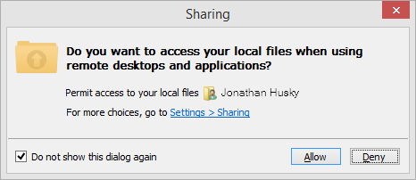
Newer Feature - Saving Files Locally
Allow Access
In OVD click Windows Start and “This PC”
Notes:
The latest Windows version of the Horizon Client will create a share on your OVD session that maps to your local drive. This allows you to save data created in your session directly on the hard drive of your laptop.
When prompted “Do you want to access your local files when using remote desktops and applications?” Click Allow.

Slide 25
Laptop Sleep Mode is BAD!
Session disconnects abruptly
Problems reconnecting to OVD
Bring a power adapter
Disable sleep when laptop is closed
Notes:
Sessions may terminate unexpectedly if your laptop or device goes into sleep mode.
Abnormal terminations can cause problems when trying to reconnect
Prevent your laptop from going to sleep
Bring a power adapter
Disable Sleep Mode when you close the laptop

Slide 26
Terminate OVD sessions properly
Save your work
Click Horizon’s, Option icon on the tool bar and select Disconnect and Log Off
Or In OVD click Start and Log Off user
Then power off laptop
Notes:
It is important to terminate your session correctly. This will prevent sessions from being abandoned which require our intervention.
Save your work.
While in an OVD session click on the Horizon Client Toolbar. Click Options
Select the option to Disconnect and Log Off.
Or While in an OVD session Click Widnows Start> Select Log Off next to your use name).
Then power off your laptop.
Note: Don’t power off your laptop until you disconnect from OVD or you may have problems starting a new session.

Slide 27
Data IS NOT SAVED BETWEEN SESSIONS
Accessing Student Files from home
http://fileserver.uconn.edu/students/
Student Home Directory (P:\)
10 Gigabytes (GB) Private Storage
Accessed via NetID.
Files are secured behind UConn’s Firewalls.
Virtual Private Network Session is required while off campus
Notes:
If you save data to UConn File Services (P:\) you can access that data by mapping that network share from other devices.
http://fileserver.uconn.edu/students/
If you are not connected to a UConn Network you will have to start a Virtual Private Network Session following these instructions first. http://remoteaccess.uconn.edu/

Slide 28
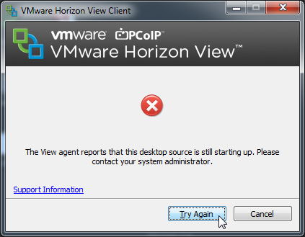
Support Tips
Your NETID is needed to help you
Explain that you are using School of Business OPIM Virtual Desktop
Provide details
Specific error messages
Screen shots help
Notes:
Your NETID is needed to help you
Explain that you are in MSBAPM
Provide details
Specific error messages
Screen shots help

Slide 29
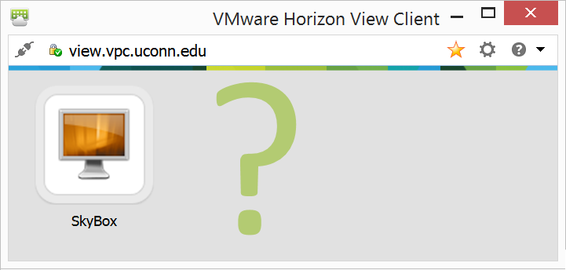
Do Not Have OPIM Virtual PC?
If you don’t have the OPIM OVD session
Send email to: cbuckridge@business.uconn.edu
czissis@business.uconn.edu
Notes:
If you have followed the instructions and do not see OPIM Virtual Desktop as an available session please send an email with your NetID, and the MSBAPM Class you are taking.

Slide 30
Select VMware Products
FREE!
Request an account
Click here to register
You must register with a valid UConn email address, all others will be ignored
Notes:
School of Business encourages you to understand hypervisor technologies. IF you are running Mac OSX VMware Fusion will act as a local hypervisor so you can install Windows and Office, and other available Windows software titles.

Slide 31
Available Products
VMware Workstation 11
VMware Player 7
VMware Fusion 7 (Mac)
VMware vCenter Server 5, 6
VMware Cloud Suite
VMware vSphere 5, 6
Discounts on study materials and Certification Exams
Notes:
There are many VMware products and services available free.

Slide 32
OPIM Software on Personal Devices
Windows ONLY versions
JMP Pro 12 (links forthcoming)
Rapid Miner 6 and Rapid Miner 5.3 (Internet)
Tableau Desktop (Links forthcoming)
Gephi (Internet)
R (Internet)
RExcel (Internet)
Excel 2013 or 2016, R, rscproxy, rcom with statconnDCOM (Internet)
IBM SPSS Data Modeler 18 (links forthcoming)
Oracle SQL Developer (Internet)
Visual Studio 2015 Community (Internet)
Office 2013, Windows 8.1 (OnTheHub)
Notes:
Windows ONLY versions
Windows ONLY versions
JMP Pro 11 (File Locker, links forthcoming)
Rapid Miner 6 and Rapid Miner 5.3 (File Locker, links forthcoming)
Tableau Desktop (File Locker, links forthcoming)
NodeXL (Internet)
Requires Microsoft Excel 2010 or 2013
R (Internet)
RExcel (Internet)
Excel 2010 or 2013, R, rscproxy, rcom with statconnDCOM
IBM SPSS Data Modeler (File Locker, links forthcoming)
Office 2013, Windows 8.1 (OnTheHub)

Slide 33
Problems connecting to OVD?
Are you connected to UCONN-SECURE
Use Ethernet instead
Have you updated to the LATEST version of the Horizon Client (https://view.vpc.uconn.edu/)
Have you tried the web client? https://view.vpc.uconn.edu/portal/webclient/index.html
Notes:
Most common OVD session issues can be corrected by
Are you connected to UCONN-SECURE
Use Ethernet instead
Have you updated to the LATEST version of the Horizon Client (https://view.vpc.uconn.edu/)
Have you tried the web client? https://view.vpc.uconn.edu/portal/webclient/index.html

Slide 34
biz.uconn.edu email
Open a web browser
Go to https://login.microsoftonline.com/
Use your firstname.lastname@biz.uconn.edu
Password (email cbuckridge@buckridge)
Change your password before adding the account to a phone or Outlook
Notes:
Open a web browser
Go to https://login.microsoftonline.com/
Use your firstname.lastname@biz.uconn.edu
Password Letmein1!
You MUST change your email at first login.
Change your password before adding the account to a phone or Outlook

Slide 35
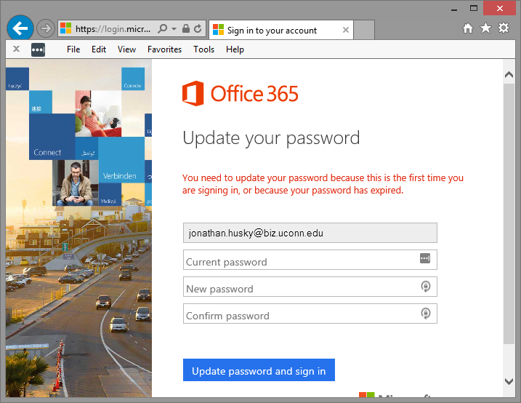
Change Your Password
Enter password provided by cbuckridge@business.uconn.edu
Provide a new password
Confirm your password
Click Update password and sign in
Notes:
Enter password provided by cbuckridge@business.uconn.edu
Provide a new password
Confirm your password
Click Update password and sign in

Slide 36
biz.uconn.edu email
If you have a long name it has been shortened to a single first name
Multiple last names are hyphenated
No Apostrophes, Example: Barnaby Rosencrantz Usansky_O’MalleyMarmaduke
Would be barnaby.usansky_omalley@biz.uconn.edu
Notes:
If you have a long name it has been shortened to a single first name
Multiple last names are hyphenated
No Apostrophes, Example: Barnaby Rosencrantz Usansky_O’MalleyMarmaduke
Would be barnaby.usansky_omalley@biz.uconn.edu

Slide 37
Activating UConn Gmail
Open a web browser and go to http://g.uconn.edu/
Click Activate/Reset Password
Notes:
You may have to activate uconn gmail
Open a web browser and go to http://g.uconn.edu/
Click Activate/Reset Password
Follow the prompts

Slide 38
Forwarding Gmail to biz.uconn.edu
Open a web browser. Goto https://accounts.google.com/
Click the Setting (gear) icon in the right
Click the Forwarding and POP/IMAP tab.
In the "Forwarding" section, click Add a forwarding address.
Enter your biz.uconn.edu email address to forward messages there.
Click Next> Proceed>OK.
A verification message will be sent to that address. Click the verification link in that message.
Return to the Gmail settings page and refresh your browser.
Select Forward a copy of incoming mail to.
Choose what you want to happen with the Gmail copy of your emails. We recommend Keep Gmail's copy in the Inbox.
Click Save Changes, found at the bottom of the page
Notes:
Open a web browser goto https://accounts.google.com/
Click the Setting (gear) icon in the right
Click the Forwarding and POP/IMAP tab.
In the "Forwarding" section, click Add a forwarding address.
Enter your biz.uconn.edu email address to forward messages there.
Click Next> Proceed>OK.
A verification message will be sent to that address. Click the verification link in that message.
Return to the Gmail settings page and refresh your browser.
Select Forward a copy of incoming mail to.
Choose what you want to happen with the Gmail copy of your emails. We recommend Keep Gmail's copy in the Inbox.
Click Save Changes, found at the bottom of the page

Slide 39
Configure Outlook
Instructions: https://goo.gl/yU9Hss
Open Outlook, when the Auto Account Wizard opens, choose Next
On the E-mail Accounts page, choose Next > Add Account.
On the Auto Account Setup page, enter your name, email address, and password, and then choose Next.
Choose Finish.
Notes:
Please go to Microsoft Office365 Support page for information on configuring your favorite mail client or device
https://support.office.com/en-us/article/Outlook-email-setup-6e27792a-9267-4aa4-8bb6-c84ef146101b
Open Outlook, when the Auto Account Wizard opens, choose Next
On the E-mail Accounts page, choose Next > Add Account.
On the Auto Account Setup page, enter your name, email address, and password, and then choose Next.
Choose Finish.

Slide 40
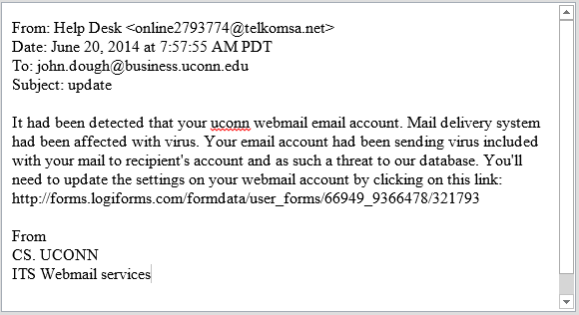
PHISHING Emails
You will NEVER be asked for a password or personal information via email, text message, or web form. Please regard ALL such requests as fraudulent.
Notes:
Don’t provide your account credentials to anyone in an email, webform or through any other request.
All requests for your username and password ARE FRAUDULENT

Slide 41
Where to Get Support
Questions:
cbuckridge@business.uconn.edu
czissis@business.uconn.edu
Support:
Help@business.uconn.edu
GBLC Room 203
-Sat 8 to 2
- Weekdays 9AM to 8PM
Notes:
Questions:
cbuckridge@business.uconn.edu
Support:
Help@business.uconn.edu
Huskytech@uconn.edu
GBLC Room 203
-Sat 8 to 2
- Weekdays 9AM to 8PM

Slide 42
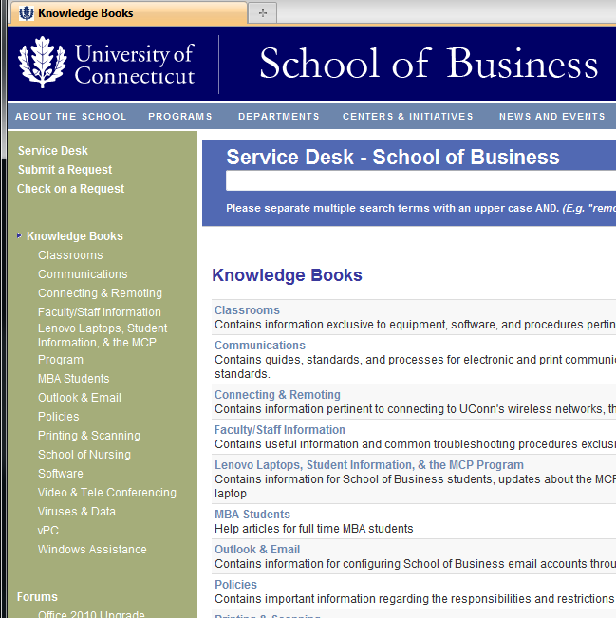
HelpSpot Support Portal
http://help.business.uconn.edu
Submit a Request
Check on a Request
Notes:
For IT information specific to the School of Business please see our support portal https://help.business.uconn.edu

